Slide 1
ANDROID PERMISSIONS Part 1

Slide 2

INTRODUCTION
In an attempt to maintain security (system integrity, user privacy) on Android, devices run each app in a limited sandbox .
Android's app permissions build upon a central design point of the Android security architecture.
By default, no app has permission to perform any operations that would adversely impact other apps, the operating system, or the user.
If app wants to use resources (e.g. camera, storage, network) or information (e.g. contacts info) outside of sandbox, must request permission.
Notes:
Sandbox: A sandbox is an isolated testing environment that enables users to run programs or open files without affecting the application, system or platform on which they run.

Slide 3
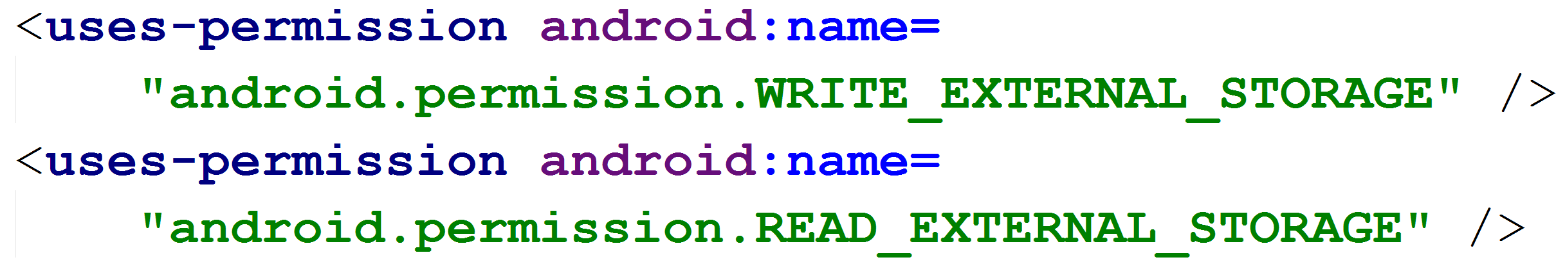
HISTORY OF PERMISSIONS
Prior to Android version 6.0, Marshmallow (API 23)
Apps requested permission at install time (during installing the app from app store)
Permissions were Listed in the AndroidManifest.xml File

Slide 4
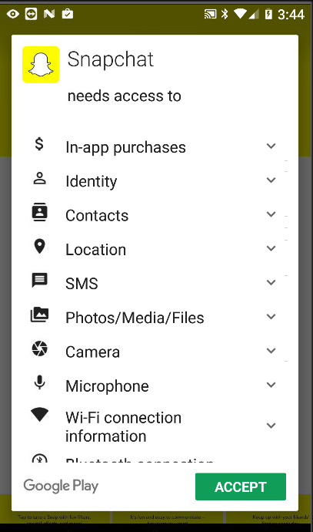
Install Time Permissions
Pre 6.0 / Marshmallow user granted permission at install time.
Google Play listed permissions for app when install was selected

Slide 5
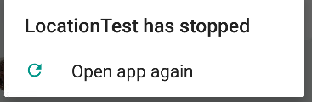
Lacks Permissions (Install time)
App stopped by system as soon as it tries to perform operation it doesn’t have permission for…
Exception: 02-09 16:03:39.857 26846-26846/org.example.locationtest E/AndroidRuntime: FATAL EXCEPTION: main Process: org.example.locationtest, PID: 26846 java.lang.RuntimeException: Unable to start activity ComponentInfo {org.example.locationtest/org.example.locationtest.LocationTest}: java.lang.SecurityException: "passive" location provider requires ACCESS_FINE_LOCATION permission. at android.location.LocationManager.getProvider(LocationManager.java:383) at org.example.locationtest.LocationTest.dumpProvider(LocationTest.java:372) at org.example.locationtest.LocationTest.dumpProviders(LocationTest.java:364) at org.example.locationtest.LocationTest.onCreate(LocationTest.java:80)

Slide 6
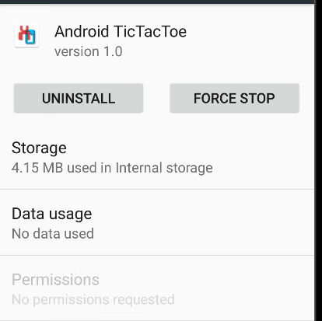
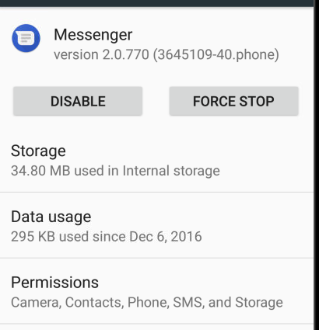

VIEWING PERMISSIONS
A user can see what permissions an app has in Settings -> Apps
Developers can see device permissions via command line:

Slide 7
Changes to Permissions
Android 6.0 / Marshmallow introduced changes to permissions
Types of Permissions
PERMISSIONS
Install time (Pre Version 6)
Dangerous/Runtime Permissions
Special Permissions
Normal Permissions
Permission Groups
Defined by the platform to protect or access powerful actions

Slide 8
Normal Permissions
Normal Permissions: These permissions allow access to data and actions that extend beyond your app's sandbox. However, the data and actions present very little risk to the user's privacy, and the operation of other apps. They fall under Install time Permissions.
• ACCESS_LOCATION_EXTRA_COMMANDS • ACCESS_NETWORK_STATE • ACCESS_NOTIFICATION_POLICY • ACCESS_WIFI_STATE • BLUETOOTH • BLUETOOTH_ADMIN • BROADCAST_STICKY • CHANGE_NETWORK_STATE • CHANGE_WIFI_MULTICAST_STATE • CHANGE_WIFI_STATE • DISABLE_KEYGUARD • EXPAND_STATUS_BAR • GET_PACKAGE_SIZE • INSTALL_SHORTCUT • INTERNET • KILL_BACKGROUND_PROCESSES • MODIFY_AUDIO_SETTINGS • NFC
• READ_SYNC_SETTINGS • READ_SYNC_STATS • RECEIVE_BOOT_COMPLETED • REORDER_TASKS • REQUEST_IGNORE_BATTERY_OPTIMIZAT IONS • REQUEST_INSTALL_PACKAGES • SET_ALARM • SET_TIME_ZONE • SET_WALLPAPER • SET_WALLPAPER_HINTS • TRANSMIT_IR • UNINSTALL_SHORTCUT • USE_FINGERPRINT • VIBRATE • WAKE_LOCK • WRITE_SYNC_SETTINGS

Slide 9
Dangerous/Runtime Permissions
Dangerous/Runtime Permissions: Runtime permissions, also known as dangerous permissions, give your app additional access to restricted data, and they allow your app to perform restricted actions that more substantially affect the system and other apps. Therefore, you need to request runtime permissions in your app before you can access the restricted data or perform restricted actions.
Dangerous Permissions are listed below: • CALENDAR: READ_CALENDAR, WRITE_CALENDAR • CAMERA: CAMERA • CONTACTS: READ_CONTACTS, WRITE_CONTACTS, GET_ACCOUNTS • LOCATION: ACCESS_FINE_LOCATION, ACCESS_COARSE_LOCATION • MICROPHONE: RECORD_AUDIO • PHONE: READ_PHONE_STATE, CALL_PHONE, READ_CALL_LOG, WRITE_CALL_LOG, ADD_VOICEMAIL, USE_SIP PROCESS_OUTGOING_CALLS • SENSORS: BODY_SENSORS • SMS: SEND_SMS, RECEIVE_SMS, READ_SMS, RECEIVE_WAP_PUSH, RECEIVE_MMS • STORAGE: READ_EXTERNAL_STORAGE, WRITE_EXTERNAL_STORAGE

Slide 10
Permissions Groups
If several permissions relate to a similar capability or feature of an app or device, the system might represent these permissions as a permissions group.
These permission groups help the system minimize the number of system dialogs that are presented to the user when an app requests closely-related permissions.
Dangerous Permissions Organized into Permission Groups: • CALENDAR: READ_CALENDAR, WRITE_CALENDAR • CONTACTS: READ_CONTACTS, WRITE_CONTACTS, GET_ACCOUNTS • LOCATION: ACCESS_FINE_LOCATION, ACCESS_COARSE_LOCATION • PHONE: READ_PHONE_STATE, CALL_PHONE, READ_CALL_LOG, WRITE_CALL_LOG, ADD_VOICEMAIL, USE_SIP, PROCESS_OUTGOING_CALLS • SMS: SEND_SMS, RECEIVE_SMS, READ_SMS, RECEIVE_WAP_PUSH, RECEIVE_MMS • STORAGE: READ_EXTERNAL_STORAGE, WRITE_EXTERNAL_STORAGE

Slide 11
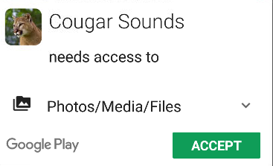
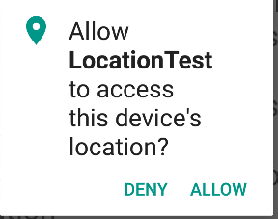
Permissions Post Android 6.0
Post Android 6.0 / Marshmallow all Normal and Dangerous Permissions still placed in app Manifest
If Device is Android 5.1 or lower OR app targets API level 22 or lower then • User must grant Dangerous Permissions at install time • Or app doesn’t install
If device is Android 6.0 or higher AND app targets API level 23 or higher then • Must still list all permissions in manifest • App must request each dangerous permission in needs while the app is running

Slide 12
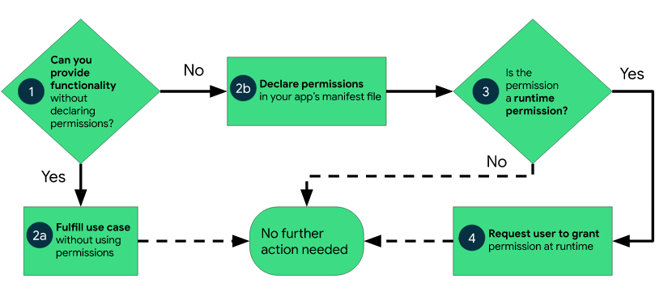
Workflow of Permissions
Determine if declaring permissions are required to access restricted data or to perform actions?
Taking photos, pausing media playback etc. can be done without declaring permissions. How?
Declare permissions in your app’s manifest file whether it is install or runtime permission.

Slide 13
THANK YOU

